Slide 1
ImageFilter 활용 13주차_01_03
한 동 대 학 교 김경미 교수

Slide 2
학습목표
ImageFilter 활용하기
이미지에 효과 넣는 기능 이해하고 활용하기

Slide 3
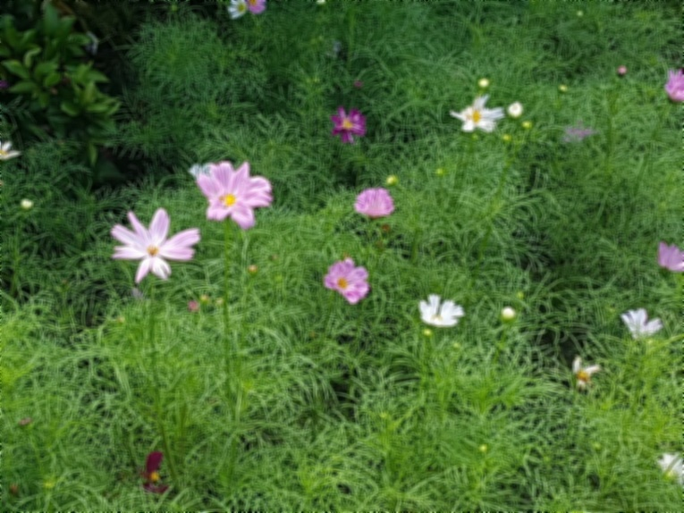
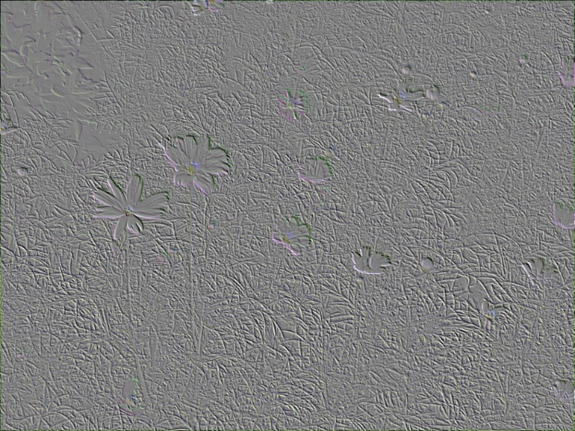
ImageFilter Module(1)
from PIL import Image, ImageFilter
try:
im01 = Image.open("flower03.jpg")
except IOError as err:
print("unable to load image")
im02 = im01.filter(ImageFilter.BLUR)
im03 = im01.filter(ImageFilter.EMBOSS)
im02.show()
im03.show()

Slide 4
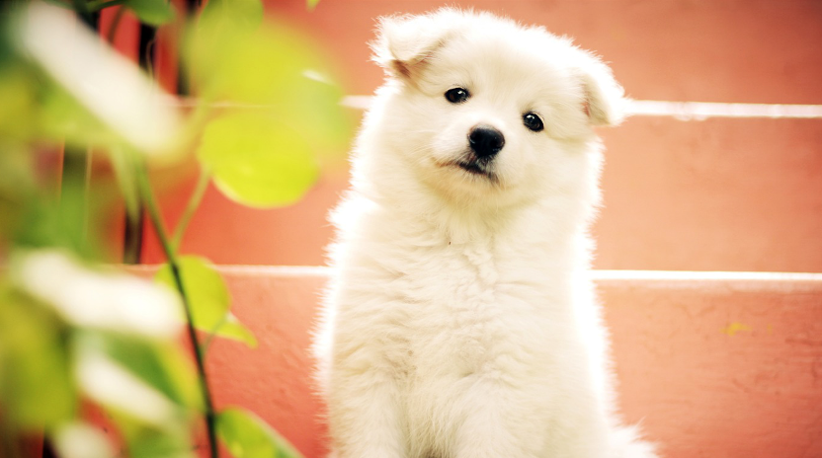
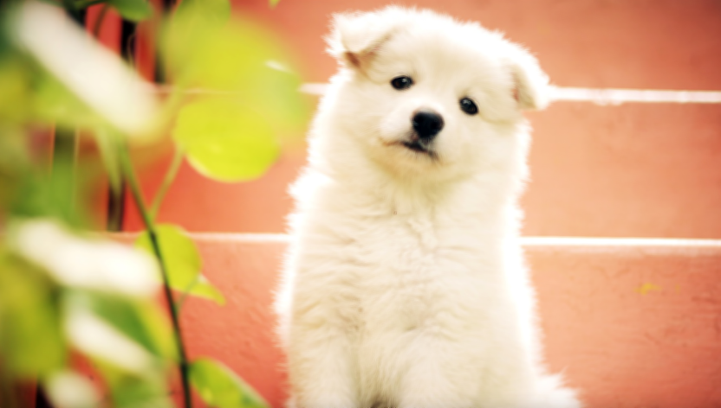
ImageFilter Module(2)
from PIL import Image
from PIL import ImageFilter
try:
img = Image.open("./dog.jpg")
except IOError as err:
print("unable to load image")
blur_img = img.filter(ImageFilter.BLUR)
img.show()
blur_img.show()

Slide 5
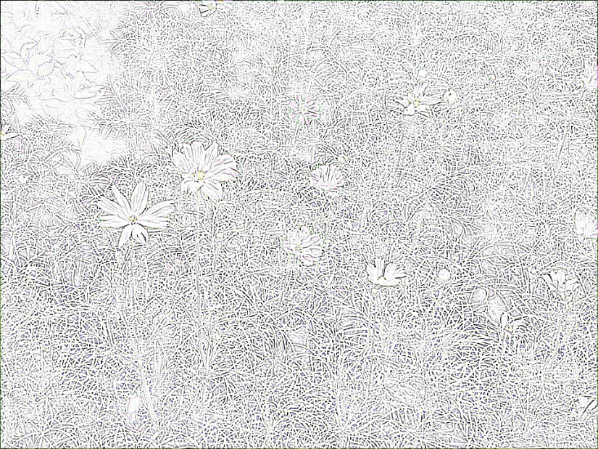
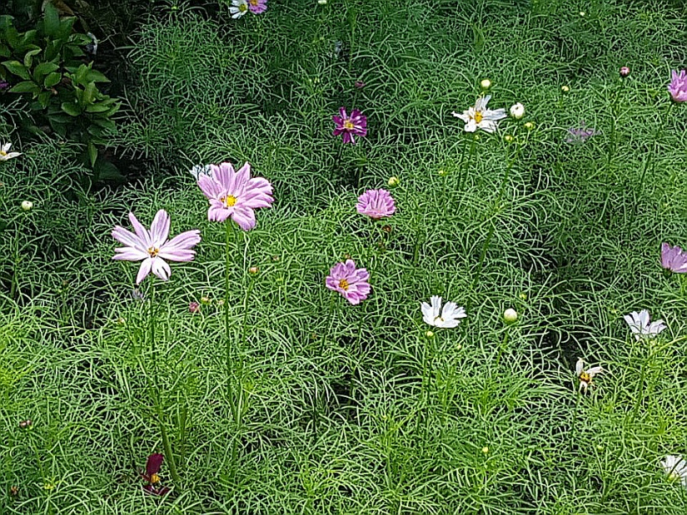
ImageFilter Module(3)
from PIL import Image, ImageFilter
try:
im01 = Image.open("flower03.jpg")
except IOError as err:
print("unable to load image")
im04 = im01.filter(ImageFilter.CONTOUR)
im05 = im01.filter(ImageFilter.EDGE_ENHANCE)
im04.show()
im05.show()

Slide 6
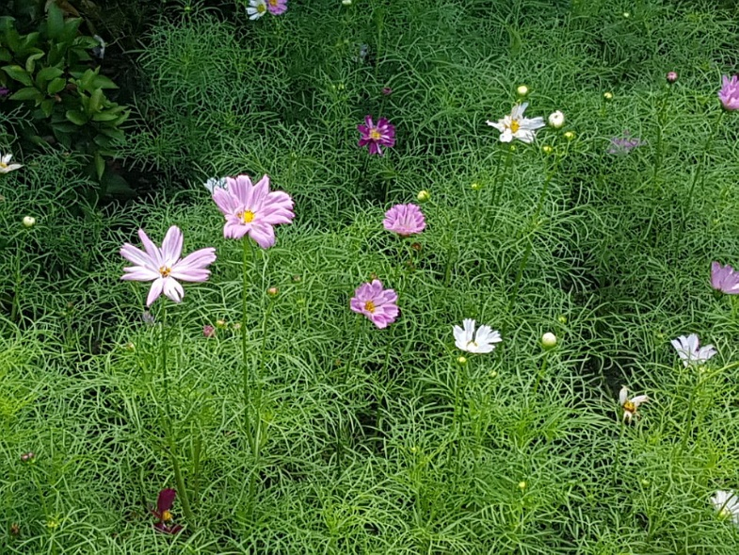
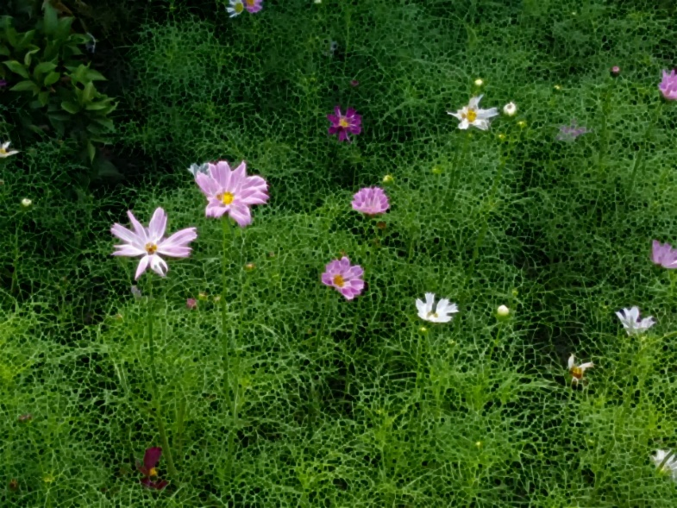
ImageFilter Module(4)
from PIL import Image, ImageFilter
try:
im01 = Image.open("flower03.jpg")
except IOError as err:
print("unable to load image")
im06 = im01.filter(ImageFilter.SHARPEN)
im07 = im01.filter(ImageFilter.MinFilter)
im06.show()
im07.show()

Slide 7
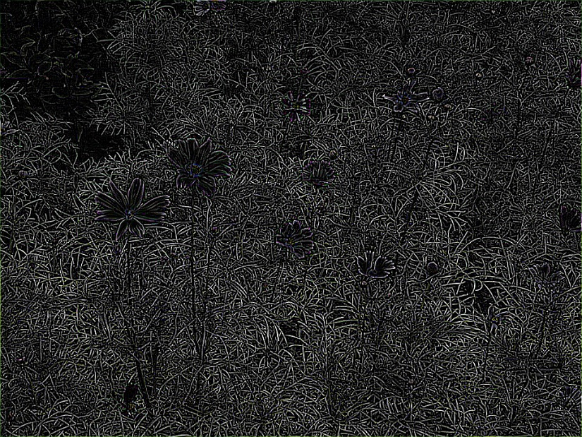

ImageFilter Module(5)
from PIL import Image, ImageFilter
try:
im01 = Image.open("flower03.jpg")
except IOError as err:
print("unable to load image")
im08 = im01.filter(ImageFilter.FIND_EDGES)
im09 = im01.filter(ImageFilter.SMOOTH)
im08.show()
im09.show()

Slide 8
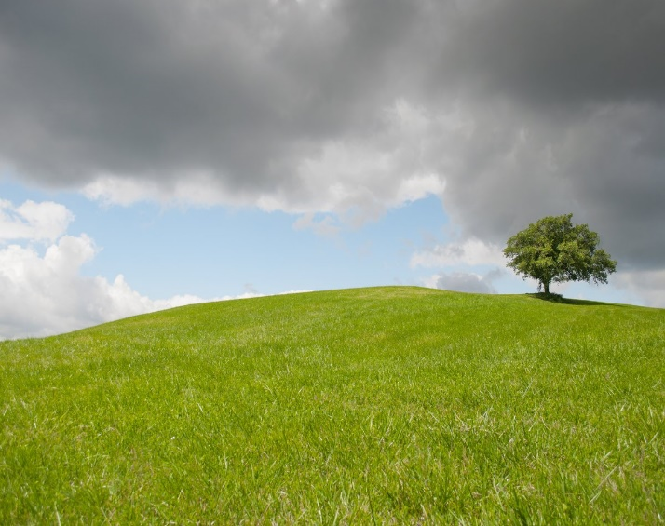
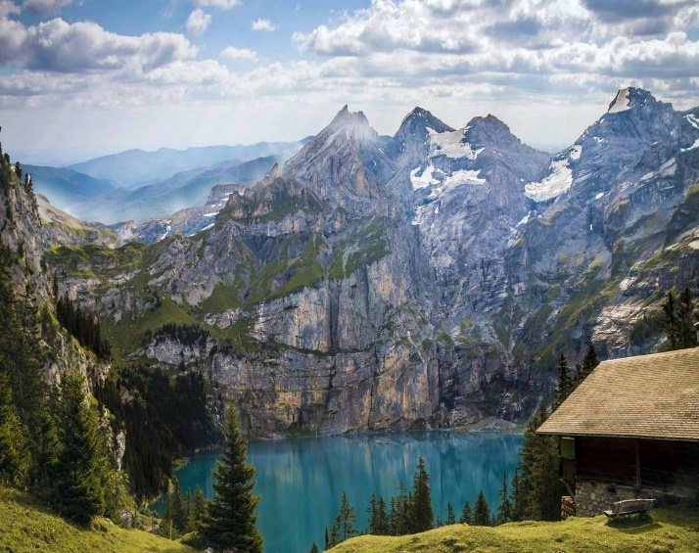
연습문제 1
같은 모드,같은 픽셀 크기 사진을 2개 준비한다
다음과 같이 시도한 후 화면에 띄운다
.blend(file1, file2, 0.3)
.blend(file1, file2, 0.7)
원 이미지

Slide 9
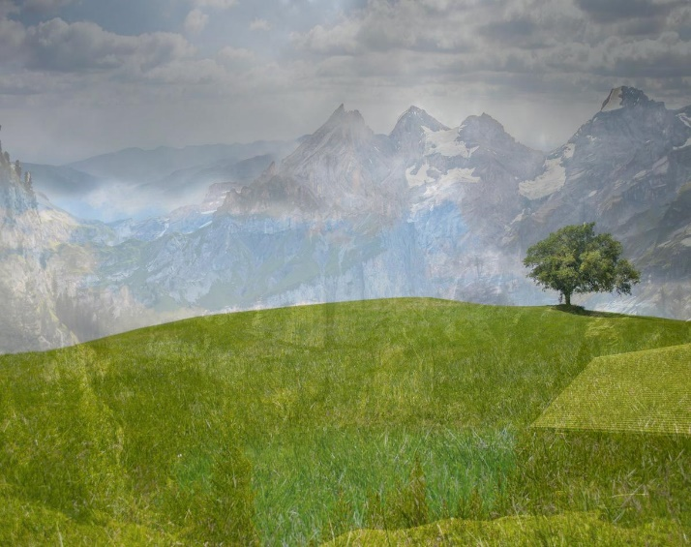
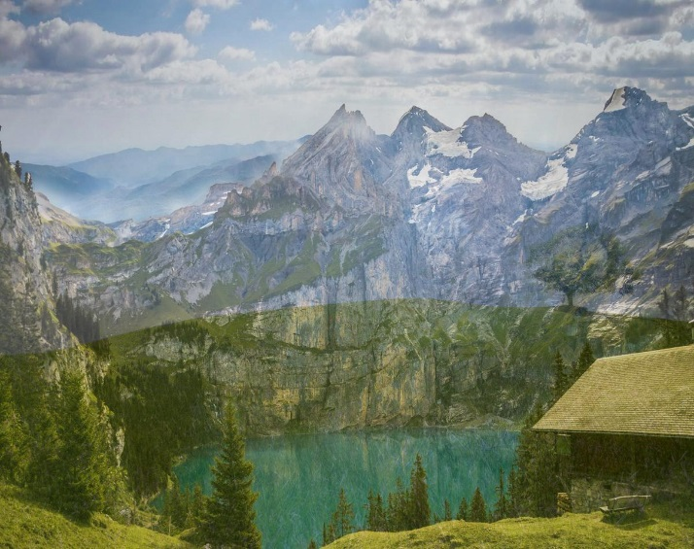
연습문제 1 코드
from PIL import Image
try:
im = Image.open("hill.jpg")
im01 = Image.open("mountain.jpg")
except IOError as err:
print("unable to load image")
im_bl=Image.blend(im, im01, 0.3)
im_bl.show()
im_bl=Image.blend(im, im01, 0.7)
im_bl.show()
im_bl.save('im_blend.jpg')

Slide 10
강의 요약
ImageFilter 활용하기
.BLUR
.EMBOSS
.SHARPEN
.FIND_EDGES

Slide 11
목표 달성 질문
다음 이미지 필터의 기능을 설명하시오
.FIND_EDGES
.SMOOTH

Slide 12
감사합니다
13주차_01_03 Imagefilter 활용

